Slide 1
Neural Style Transfer
Varsha m s
2021503057

Slide 2
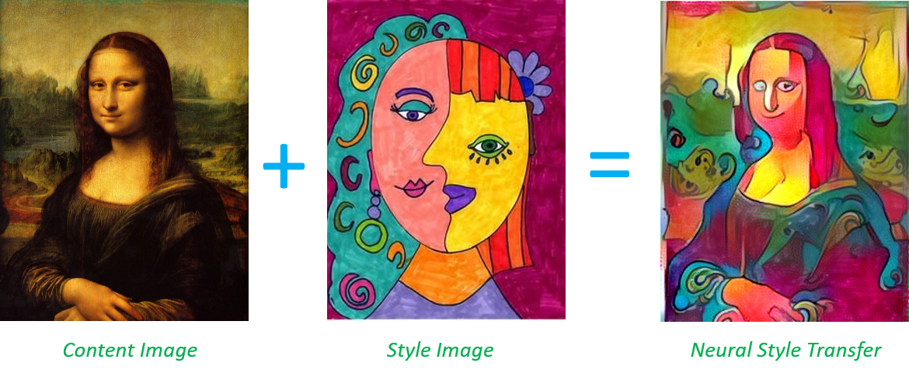
Problem Statement
Neural style transfer is a technique that combines the content of one image with the style of another image to create a new image. The challenge lies in finding an efficient way to extract and blend content and style features while preserving the content of the original image.

Slide 3
Proposed System
System Overview: The proposed system utilizes TensorFlow and the VGG19 model for implementing neural style transfer.
Key Components:
VGG19 Model: Pretrained on ImageNet, used for feature extraction.
Content and Style Representation: Extracts features from the content and style images at specified layers of the VGG19 model.
Loss Computation: Defines content loss and style loss to quantify the difference between feature representations of the input image and target style/content.
Gradient Descent: Optimizes the input image to minimize the total loss, iteratively updating it towards the desired style.
Workflow:
Load content and style images.
Preprocess images for VGG19.
Extract features from the VGG19 model.
Compute content and style losses.
Optimize input image to minimize total loss.
Display intermediate results.
Save the final stylized image.

Slide 4
System Development Approach
Data Preparation: Load content and style images.
Model Configuration: Load VGG19 model, define style and content layers.
Feature Extraction: Extract features from content and style images using the VGG19 model.
Loss Computation: Calculate content and style losses based on feature representations.
Optimization: Use gradient descent to optimize the input image.
Visualization: Display intermediate and final stylized images.
Evaluation: Assess the quality of the stylized image.
Deployment: Save the final stylized image.

Slide 5
Algorithm
Load and Preprocess Images: Load content and style images, preprocess for VGG19.
Feature Extraction: Extract content and style features using VGG19.
Loss Calculation: Compute content and style losses.
Optimization: Update the input image to minimize total loss.
Visualization: Display intermediate and final stylized images.
Save Result: Save the final stylized image.

Slide 6
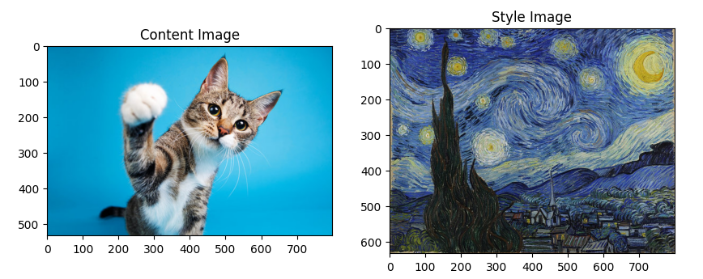
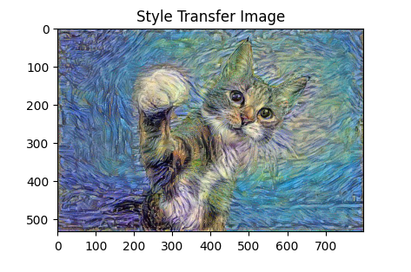
Result
The system successfully generates a stylized image that combines the content of the content image with the style of the style image. Intermediate results are displayed during the optimization process, and the final stylized image is saved.

Slide 7
Conclusion
The implementation demonstrates the effectiveness of neural style transfer using TensorFlow and the VGG19 model. By iteratively optimizing the input image, it achieves a visually appealing stylized image that combines the content and style of the input images.

Slide 8
References
Gatys et al., 2015. A Neural Algorithm of Artistic Style
TensorFlow Documentation: Neural Style Transfer
Huang, X., Belongie, S., & Singh, S. (2017). Arbitrary style transfer in real-time with adaptive instance normalization. In Proceedings of the IEEE International Conference on Computer Vision (pp. 1510-1519).
Johnson, J., Alahi, A., & Fei-Fei, L. (2016). Perceptual losses for real-time style transfer and super-resolution. In European conference on computer vision (pp. 694-711). Springer, Cham.
Dumoulin, V., & Visin, F. (2016). A guide to convolution arithmetic for deep learning. arXiv preprint arXiv:1603.07285.

